Slide 1
A Look at a Root Cause for DNS Latency
What frustrates Internet users most? Slow DNS
Ties de Kock & Lia Hestina | MENOG 24 | 4 December 2024

Slide 2
The Problem

Slide 3
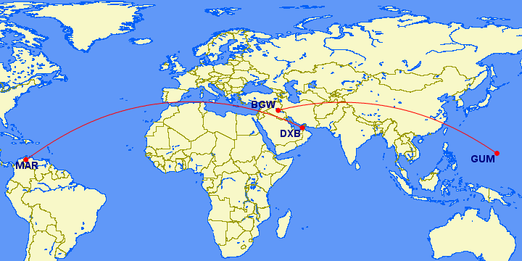
What Frustrates Internet User Most?
High DNS Latency
Traffic not Local
Due to routing, slowing down experience
Slow response due to detour around the world
Notes:
Second icon should represent not local, but it’s difficult. We should illustrate frustration somehow.
Question: "What frustrates internet users most?"
Problem: High DNS latency due to routing far from users, slowing down experiences.
Subproblem: Traffic is not kept local, traverses the world, slowing down responses and it crosses many networks
DEtour or world tour

Slide 4
How Is RIPE NCC’s AuthDNS Reached from the Middle East?
1. | Target: RIPE NCC AuthDNS service
2. | From 215 probes in the Middle East (ME)
3. | DNS and NSID measurements
4. | We got replies from 187 probes
5. | You can do this too!
Notes:
We used RIPE atlas to measure the latency _and target server_ of DNS traffic. We observe that some probes used the authdns node in Bahrain (traffic kept local), and other probes get results from locations as far away as Venezuela or Guam. Those are very suboptimal choices in routing.
We measured towards RIPE NCC authdns, which is a anycast DNS deployment

Slide 5
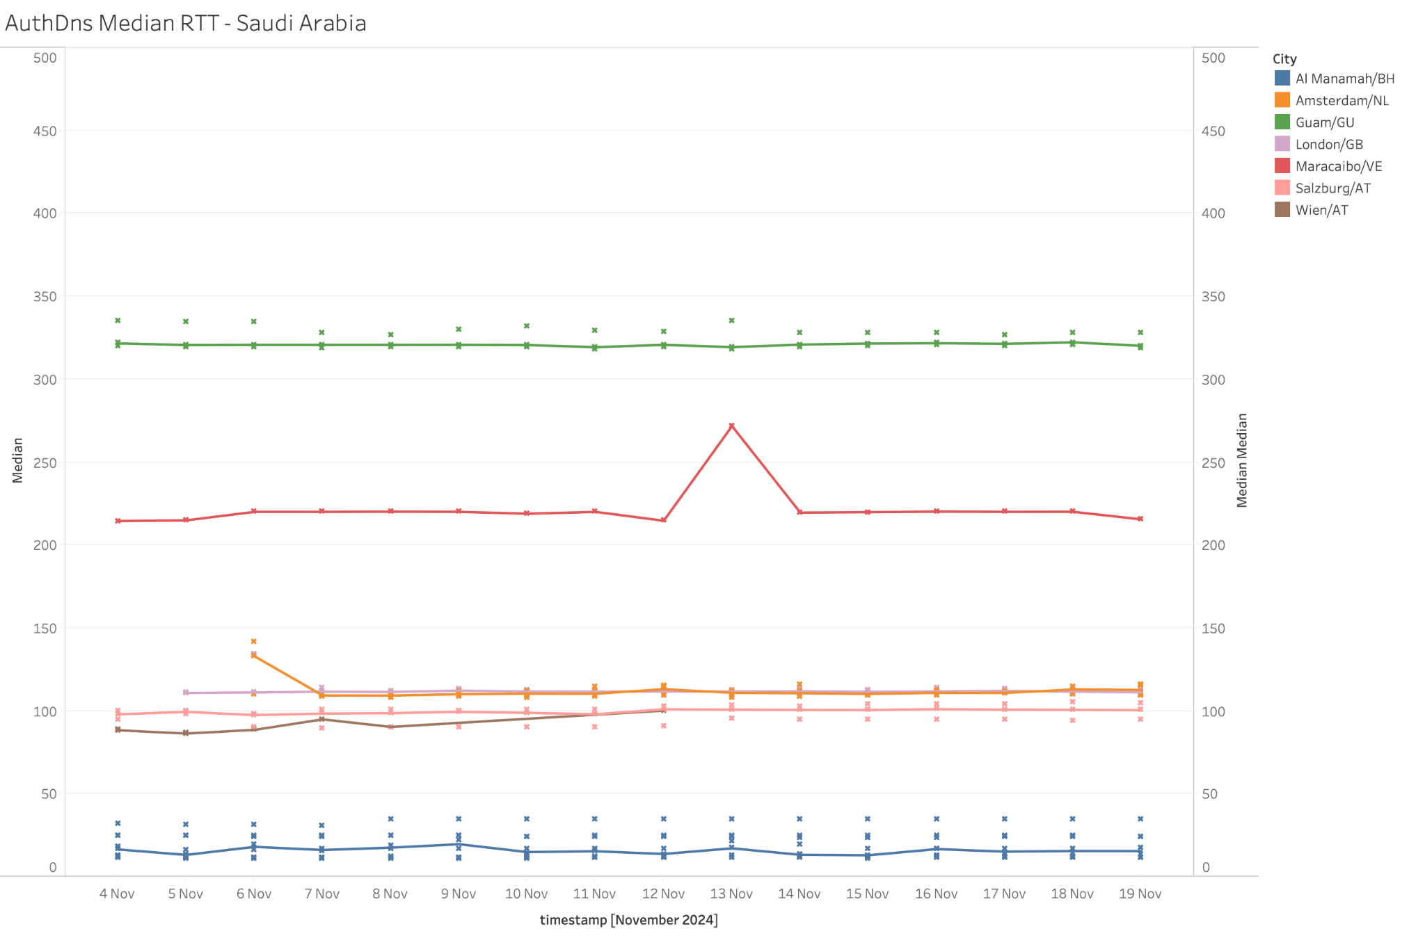
Let’s Take a Closer Look
Hold this thought (RTT)
All RTTs are measured from Atlas probes in the Middle East
Middle East (BH) <50 ms
European Countries +/- 100 ms
Latin America (VE) +/- 200 ms
Pacific Ocean (GU) >300 ms
The further it gets the answer from, the higher the latency.
Pacific Ocean
Latin America
World Detour
MinRTT
Europe
11 probes give >300ms result
89 >100ms
39 within 50 ms
Middle East
Notes:
All this analysis is based on measurements between 4-19 november. https://atlas.ripe.net/measurements/81446294/
Graph #5 shows the location of the probes with open circles; colour again represents the autdns instance used on the selected day, size represents the round trip time. The 6th graph shows the round trip times for probes in Saudi Arabia vs time. This most clearly shows how Guam and Venezuela are far from optimal choices, and how Bahrain wins from London/Amsterdam/Vienna.
Pic 1.
Pic 2.
Pic 3:
STC = Saudi Telecom Group, main provider in Saudi Arabia. That explains why the BH instance is picked up by several probes in SA. The networks are related, short paths in BGP from one to the other. RTT is good, but one probe AS42642 in BH has higher latency than from probes in SA

Slide 6
Let’s Analyse:
No local answer
World Detour
Minimum RTT
Bahrain AuthDNS node
10 probes got answer via Guam, a Pacific island
5 from India
4 got answer from Latin America, Venezuela
168 probes got answer from Western Europe
11 probes give >300ms result
89 >100ms
39 within 50 ms
11 out of 187 probes answered by Bahrain AuthDNS node
MinRTT <60ms
This AuthDNS node is hosted by STC (Saudi Telecom Group), some probes in SA got response from Bahrain node
Notes:
Remind the RTT grouping from previous slide.
Bahrain node: KW & SA only ; Some ASNs in Bahrain still go outside the country with rtt 100ms. AuthDNS node is hosted by STC (Saudi Telecom Group), some probes in SA got response from Bahrain node.
Across the ocean: AE, TR, IQ, LB, PS, SA
Most answer from AT & NL
What does it say? Suboptimal routing due to no closer node (list country with no AuthDNS node) or routing policy (which ASNs will be shown later)
Do we need to point them where to look at?
What situations do we see when looking in BGP:
Networks that have a remote connection to an IXP where k-root is directly connected. AuthDNS is a direct neighbour of probe-AS
This network is also present at other IXPs in the region. But to have a shorter path, AuthDNS needs to be directly present at this IXP (UAE-IX)

Slide 7
The Solution

Slide 8
Keeping Traffic Local with AuthDNS
Anycast
Contribution
Security
Local AuthDNS is a machine that announces the AuthDNS prefixes.
It helps reduce path lengths for your network and peers.
Local DNS server reduces latency.
More deployment increases resilience.
Anycasted servers can be hosted in more networks.
Notes:
AuthDNS: Anycasted Local DNS servers reduce latency. More deployments increases resiliency.
Contributing: Because they are anycasted, AuthDNS servers can be hosted in many networks.
Security: Local AuthDNS is a BGP peer that announces the AuthDNS prefixes. Having it local reduces path lengths for your network & peers.
There are no routing security mechanisms that prevent a same-origin hijack - having it close makes hijacks harder.
Examples: answer

Slide 9
What is AuthDNS?
AuthDNS is an authoritative DNS server responsible for serving various DNS zones
Zones served:
ripe.net,
in-addr.arpa,
ipv6.arpa
RIR Zones: RIPE NCC + other RIR reverse DNS zones (crucial service)
ccTLDs for smaller TLDs: SY, JO, PS, etc (and others)
Low Effort, High Impact: You provide the server, RIPE NCC handles the rest.
Risk: AuthDNS is similar to any BGP peer you add
Most benefit from adding an AuthDNS server in: Türkiye, Iran
For who? Big ISPs or parties offering an IXP port
Notes:
List of ccTLDs hosting authDNS in ME: SY, JO, PS
Explain why it’s crucial with example. A Real-World Example. During denial-of-service (DoS) attacks, certain instances of an AuthDNS server might be overwhelmed. However, other instances will continue to function, handling DNS queries without service degradation. This redundancy ensures resilience and reliability, even during large-scale attacks.
Why Should You Host an AuthDNS Node?
Faster DNS Resolutions: Hosting an AuthDNS node nearby accelerates DNS queries, particularly reverse DNS queries, improving overall network performance.
Contribution to Global Internet Stability: By hosting, you enhance the resilience and redundancy of global DNS infrastructure.
Low Effort, High Impact: Hosting is simple—you
provide the server, and the RIPE NCC handles
maintenance, security, and updates.

Slide 10
RIS for Routing Issues/Anomaly Detection
RIS
Transparency
Security
RIS receives the same data any BGP peer receives. You are already widely sharing this!
Allow Researchers to spot attacks using shared data across networks
Publicly available data supports mutual improvement

Slide 11
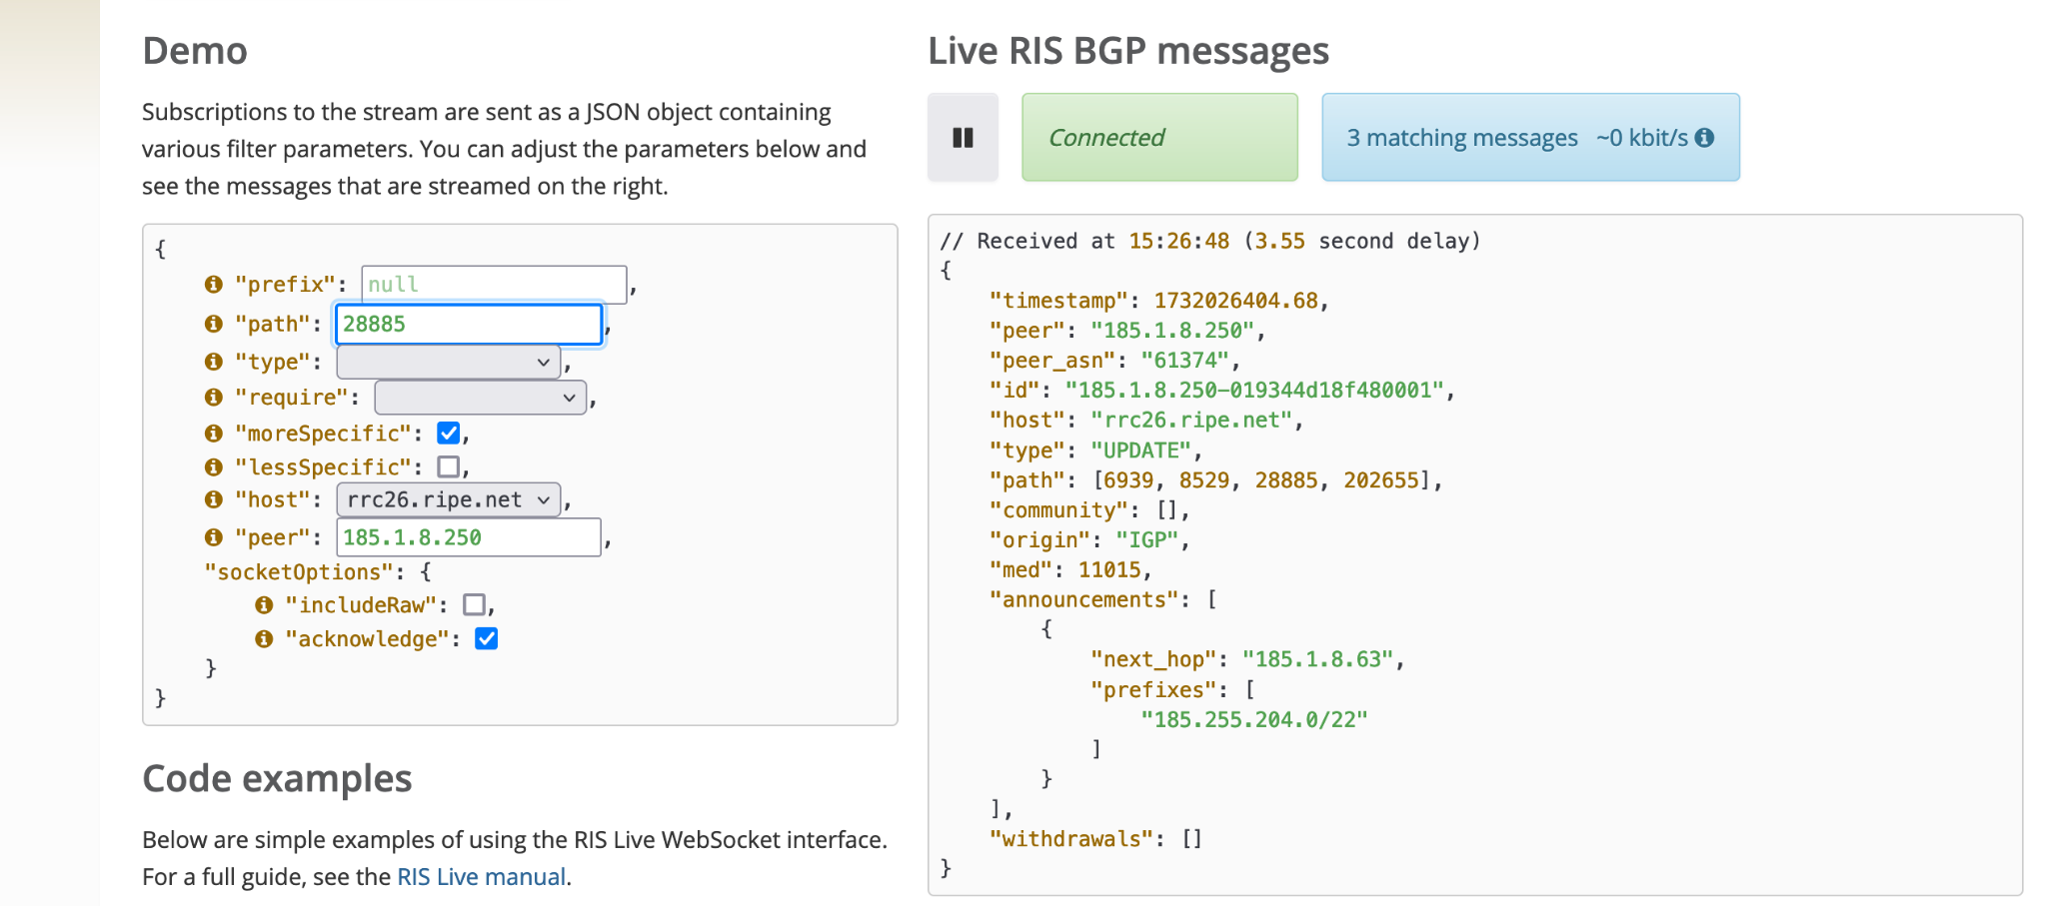
RIS: Routing Information Service
Hey RIS, is my Prefix announced in Oman(?) on November X?
RIS allows Researchers to detect possible attacks. Find out using
RIPEstat: RIPEstat uses RIS routing data for network insights & diagnostic
RIS Live: Live BGP announcement
Open source that relies on our services: BGPalerter, …
Action: Peer(?) with RIS and work together for a more secure(?) routing
Which countries are far from our infrastructure: IR, IQ, SY, LB, JO, SA, AE
Which Networks:
https://observablehq.com/@emileaben/what-peers-would-decrease-as-distance-to-ris-most
Example screenshot of RIS LIVE
Notes:
RIS: allow researchers to detect possible attacks. with data sharing diagnose from other locations/use information from other locations, get information from ripestat. It may be scary but it’s helping each other to improve, data is already public in one way or the other.
Action: explain how it works with sharing information for the better of all.
BGPalerter: Get alerted when something goes wrong with your prefix so you can fix issues and stay in control of your network. Open source tool by the community

Slide 12
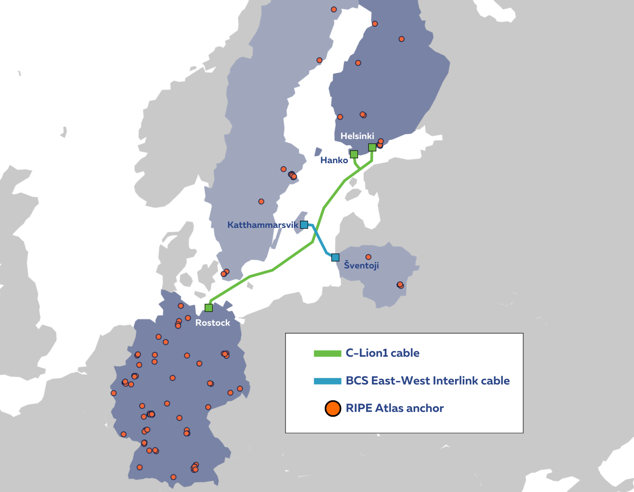
RIPE Atlas Anchors Use Case: Submarine Cable Cuts
Does the Internet route around damage?
On 16 November a submarine cable got cut, on 17 November another one
Did the Internet route around this damage?
We used RIPE Atlas Anchors to investigate:
https://labs.ripe.net/author/emileaben/does-the-internet-route-around-damage-baltic-sea-cable-cuts/
Findings:
No increased packet loss
20-30% of paths had increased latency (0-20ms)

Slide 13
RIPE Atlas Anchor Deployment
The needs for cable cut analysis
ME Countries With Less than 5 Anchors
Bahrain | Oman
Egypt | Palestine
Iraq | Qatar
Israel | Saudi Arabia
Jordan | Syria
Kuwait | Yemen
Lebanon
The Baltic Sea Cable cuts analysis was possible because a sufficient number of RIPE Atlas Anchors was deployed in the region (on both sides of the cables).
We consider 5 RIPE Atlas Anchors with enough diversity to be the minimum on each side.
Check out this page to see if your country needs more anchors for this type of measurement:
https://sg-pub.ripe.net/emile/tmp/cc2anchor.csv
Notes:
Iran, Islamic Republic of (9), United Arab Emirates (11), Türkiye (13)

Slide 14
Hand-On Solution - Be Proactive with RIPE Atlas
Global network of sensors monitoring Internet paths in real time
Measurements
Coverage
Access
Accessible via WEB GUI, API, CLI tools. Can be the basis for your own tools
Run 6 types of measurements to any target, with views from outside your network
Over 12K global probes, credit system and trusted source
Notes:
Now give this simple analogy for audience about what we mentioned already.
AuthDNS: Like a reliable librarian, it quickly finds and provides the exact book (DNS answer) you’re looking for, ensuring you get accurate results.
K-root: Think of it as a well-connected guide at a global help desk, directing internet traffic efficiently and resolving queries from anywhere in the world.
RIS (Routing Information Service): Like a weather station for the internet, it collects real-time data on traffic flows and routing changes, helping you predict and prepare for network "storms."
Now let’s talk about RIPE Atlas
RIPE Atlas: Imagine a vast network of sensor scattered worldwide, constantly checking roads (internet paths) to report on speed, obstacles, and detours in real time.

Slide 15
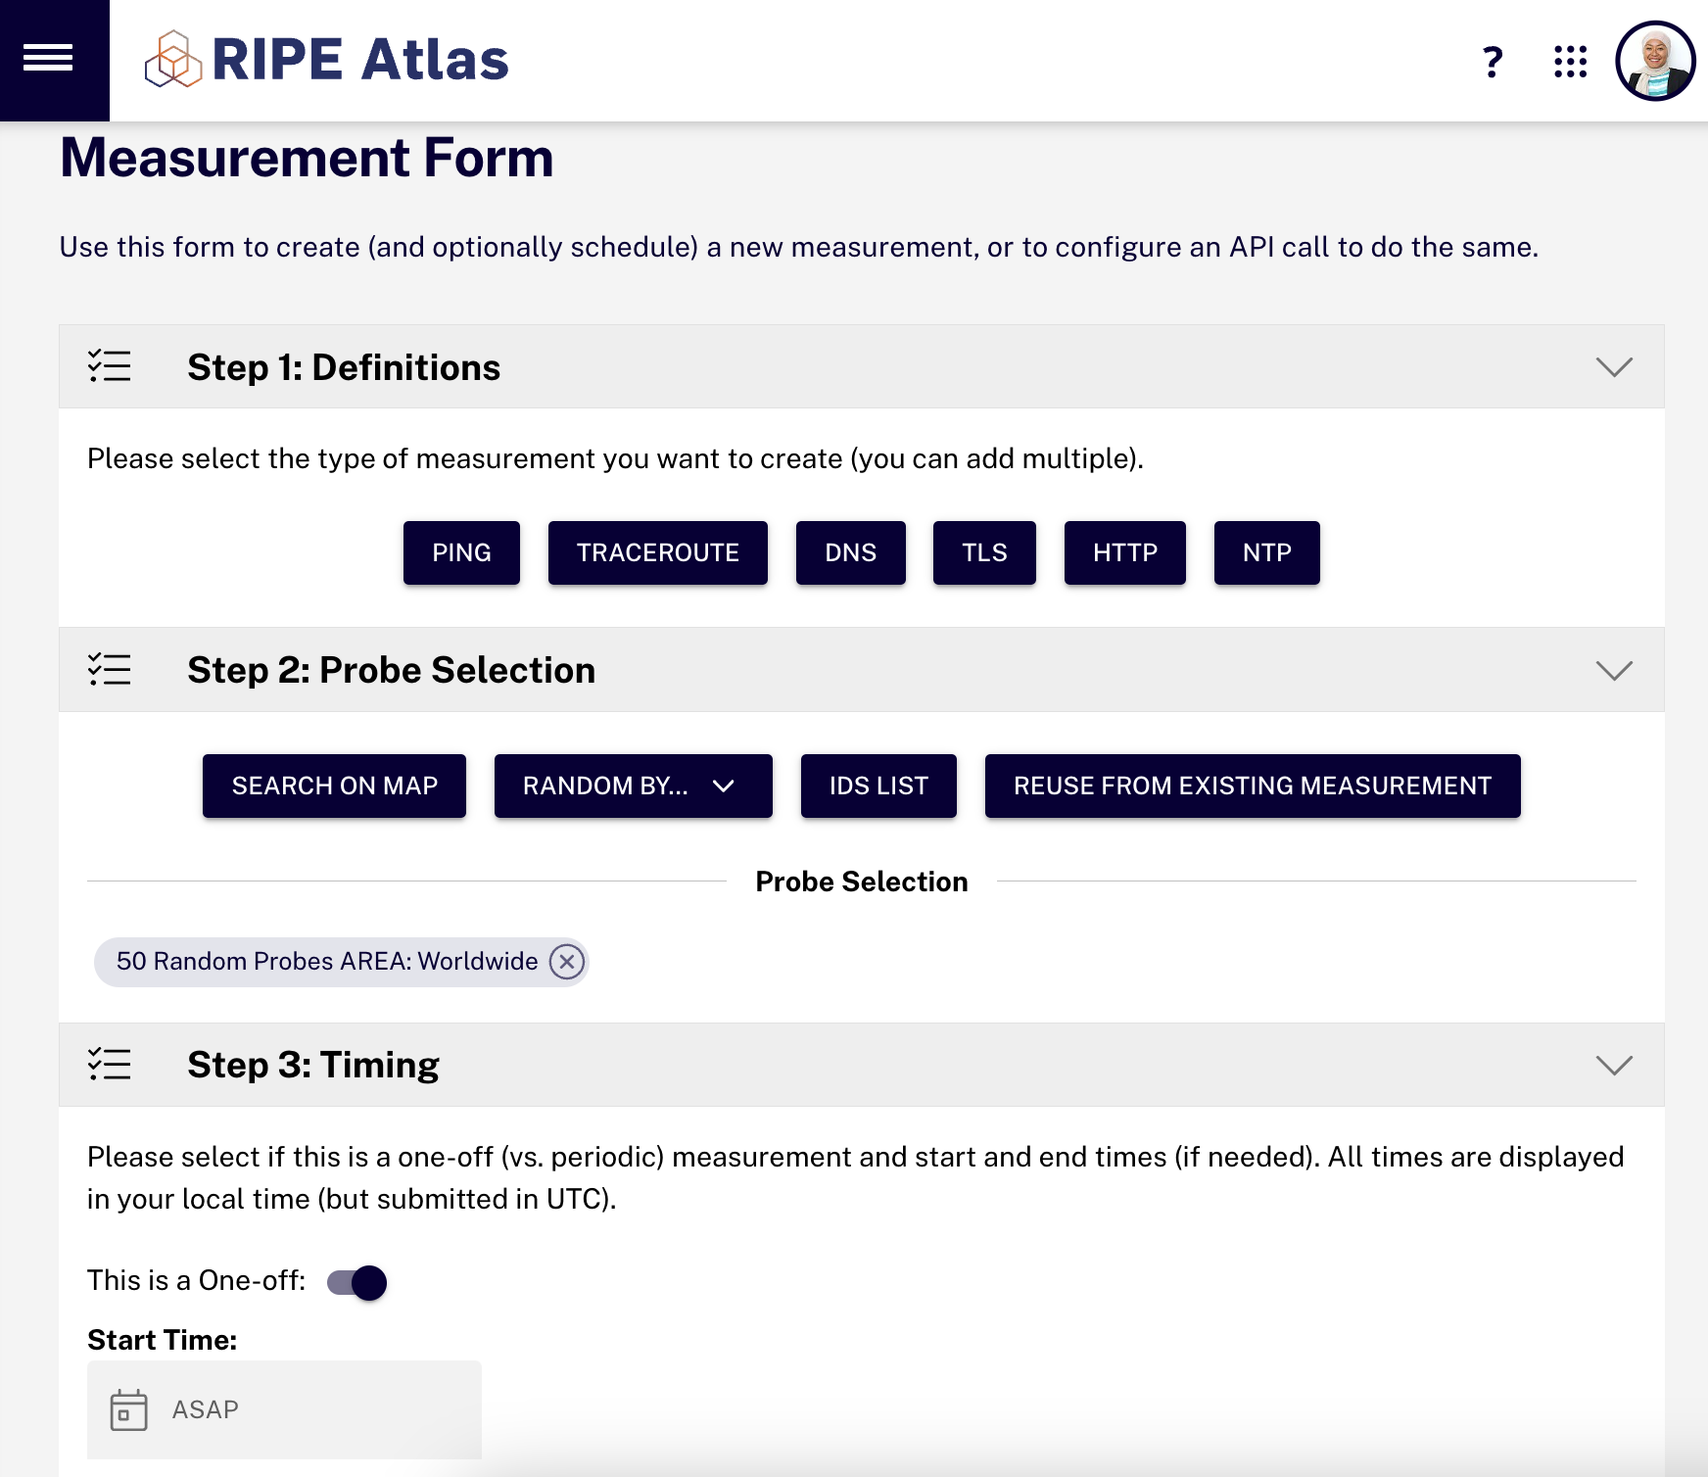
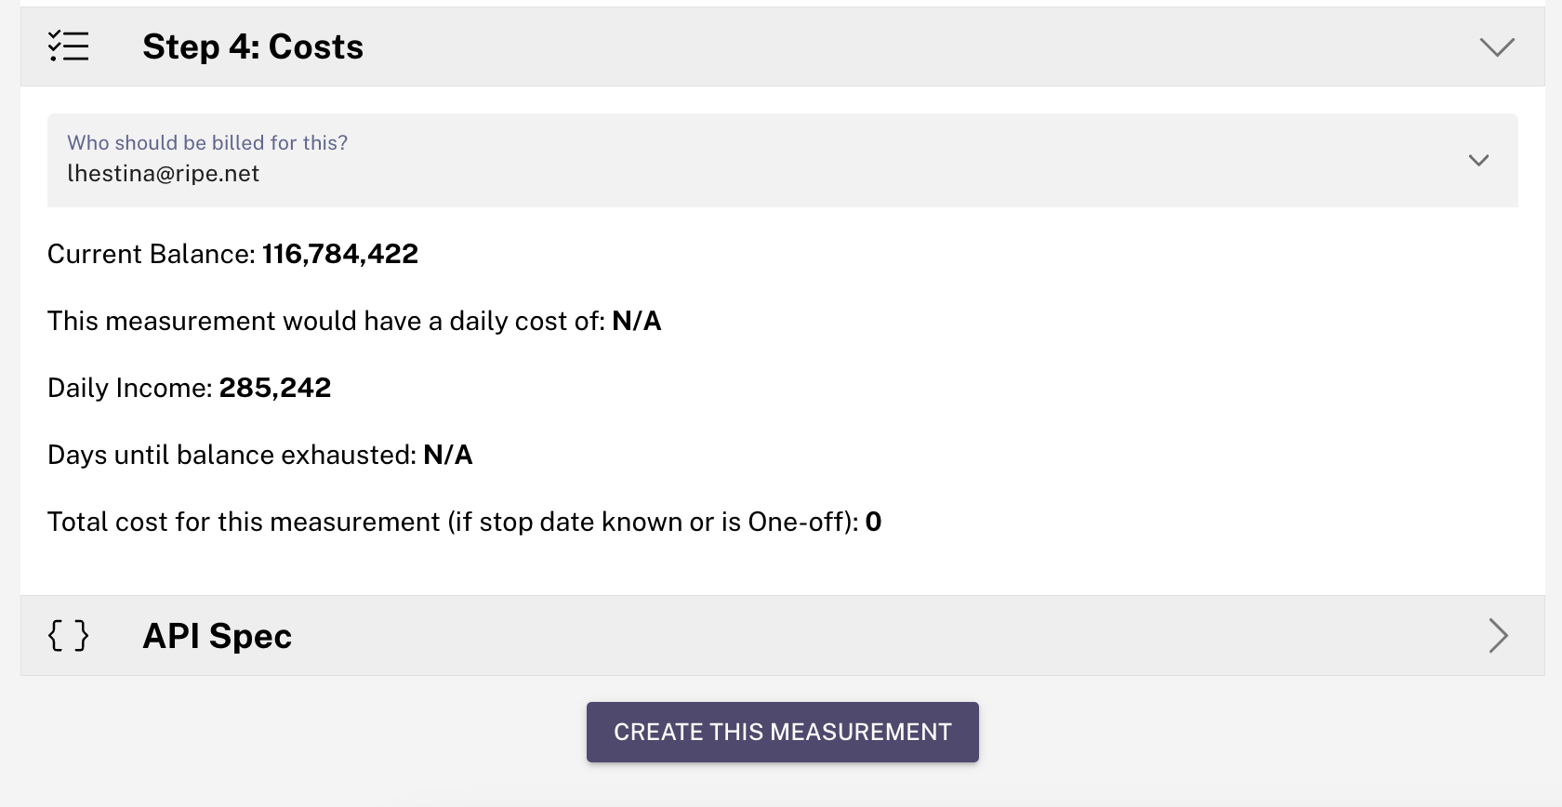
Try It Yourself: Create a Measurement
https://atlas.ripe.net/measurements/form/
Create a RIPE NCC SSO account
Redeem 200K credits MENOG2024
Get started:
Notes:
The 200K credits is a special offer. Highly recommended.

Slide 16
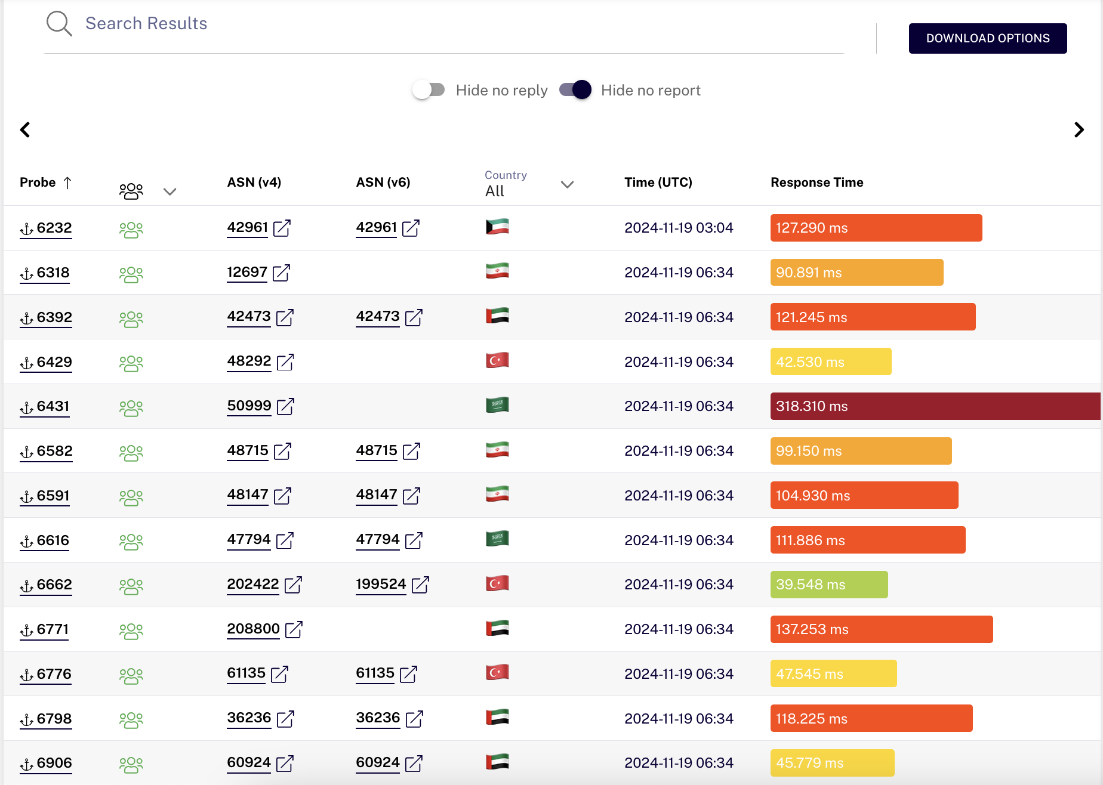
Analysing Results

Slide 17
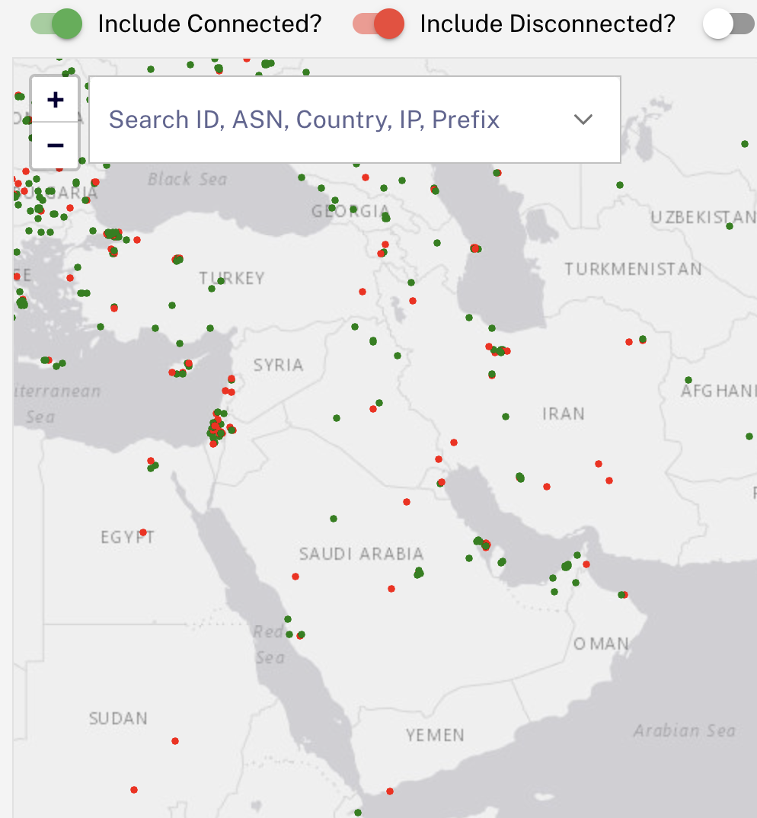
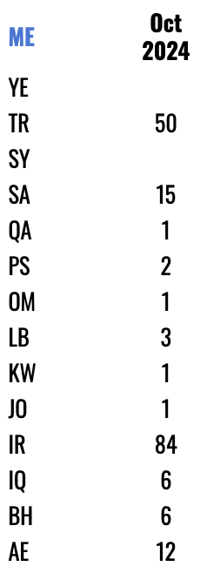
RIPE Atlas in the Middle East
How you can help
Extremely low coverage in many countries, we need:
More topological diversity
Especially:
More diversity in network & type of location:
end user vs. core
More in eyeball networks
Paths via IXPs

Slide 18
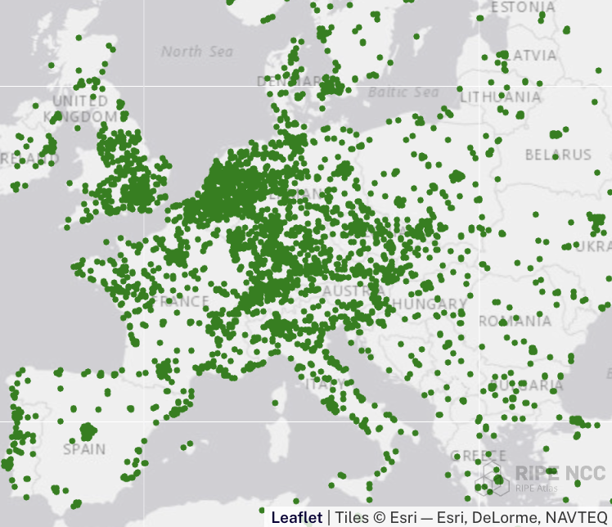
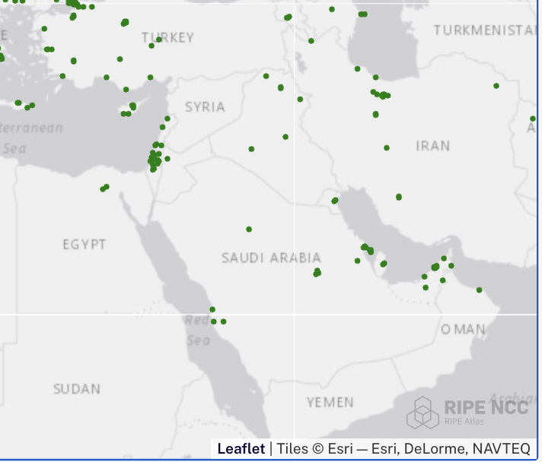
RIPE Atlas Coverage Density
Europe
Middle East
Notes:
Europe enough coverage in diverse network, enough topological diversity too: people has enough resource to make meaningful data & analysis.
We need your contribution to join us in this boat
Pic 2.
Pic 3:
STC = Saudi Telecom Group, main provider in Saudi Arabia. That explains why the BH instance is picked up by several probes in SA. The networks are related, short paths in BGP from one to the other. RTT is good, but one probe AS42642 in BH has higher latency than from probes in SA
We see some situations:

Slide 19
Summary
Problem: Slow DNS response times frustrate internet users
Cause: High latency due to inefficient routing, with traffic often travel not locally
Solution:
Keep DNS traffic local by hosting more AuthDNS (anycasted DNS servers)
Host more RIPE Atlas in diverse location to provide real time view on the field
Use RIS data (and peer with RIS*) to mutually help detects BGP hijacks or misconfiguration across networks
Benefit: Local DNS reduces latency, improve user experience, and enhances security by reducing paths lengths and hijack risks
Tools: Use RIPE Atlas for measuring DNS latency and assessing route inefficiencies.
Deployment: Target countries to improved local DNS infrastructure include: AE, SA, IR, IQ, SY, LB, JO, KW, LB, OM, PS, QA and TR.
Call to action per country recommendation
Notes:
Explain why it’s important to have one or more local authDNS highly
Having more diverse vantage points (end user network to see how your customer reach you, core to see stability etc)
Direct peering may help impor

Slide 20
Per Country Recommendations: Oman
RIPE Atlas
RIS & AuthDNS
Network Operator
We want to distribute probes to:
50010 Nawras-AS
204170 awasr
212661 Vodafone-Oman
Where?
End user network
Core network
IXPs
Networks that will improve hops to RIS infrastructure:
IXP route servers
50010
28885
8529
204170
Host AuthDNS in:
Oman IX?
AS28885 or AS8529
AS50010
Evaluate the paths from your network to key infrastructure AS28885 goes via server in India
With only 1 probe connected, local support is urgently needed

Slide 21
Per Country Recommendations: United Arab Emirates
RIPE Atlas
RIS & AuthDNS
Network Operator
We want to distribute probes to:
328286 Libyana-Mobile-AS
328200 Al-Madar-Al-Jadeed
59625 KorekTel
328539 Giga-Communication
199739 Earthlink-DMCC-IQ
51684 ASIACELL
13335 CLOUDFLARENET
206206 KNET
Where?
End user network
Core network
IXPs
Networks that will improve hops to RIS infrastructure:
IXP route servers
203214
208293
61317
60051
Host AuthDNS in:
AS5384
UAE-IX
Evaluate the paths from your network to key infrastructure
3491 | 15802 | 36236 | 57187
5384 | 16509 | 42473 | 200851
12008 | 29802 | 44477 | 208800
15412 | 31898 | 45102

Slide 22
Per Country Recommendations: Bahrain
RIPE Atlas
Network Operator
We want to distribute probes to:
51375 VIVABH
31452 ZAIN-BH-AS
39273 Kalaam-Telecom
16509 AMAZON-02
35729 VIACLOUD-AS
35568 AMWAJ-AS
Where?
End user network
Core network
IXPs
Evaluate the paths from your network to key infrastructure. These Network got answer from Amsterdam, NL
5416
16509
39273

Slide 23
Per Country Recommendations: Iraq
RIPE Atlas
RIS & AuthDNS
Network Operator
We want to distribute probes to:
203214 HulumTele
206206 KNET
59588 ZAINAS-IQ
58322 halasat
51684 ASIACELL
199739 Earthlink-DMCC-IQ
203735 Capacities-LTD
59625 KorekTel
44217 IQNETWORKS
205254 Valeen
Where?
End user network
Core network
IXPs
Networks that will improve hops to RIS infrastructure:
IXP route servers
208293
203217
57324
203214
Host AuthDNS in:
Iraq IXP
AS203214
AS199739
Evaluate the paths from your network to key infrastructure
21277
39216
57908
198183

Slide 24
Per Country Recommendations: Jordan
RIPE Atlas
RIS & AuthDNS
Network Operator
We want to distribute probes to:
8697 JTC-AS8697
42912 XOLJO
21859 ZEN-ECN
13335 CLOUDFLARENET
47887 NEU-AS
48832 Zain-Jo
9038 BAT-AS9038
8376 Jordan Data Communications
Where?
End user network
Core network
IXPs
Networks that will improve hops to RIS infrastructure:
IXP route servers
8376
8697
48832
Host AuthDNS in:
IXP
AS48832
AS8376
Evaluate the paths from your network to key infrastructure: AS38968
With only 1 probe in Jordan urgently need to get help getting probes connected in Jordan

Slide 25
Per Country Recommendations: Kuwait
RIPE Atlas
RIS & AuthDNS
Network Operator
We want to distribute probes to:
42961 GPRS-AS
47589 KTC3G
29357 WATANIYATELECOM-AS
21050 FAST-TELCO
9155 Qnet
42781 ZNETAS-KW
Where?
End user network
Core network
IXPs
Host AuthDNS in:
IXP
AS42961
AS29357
Evaluate the paths from your network to key infrastructure:
42642
12061
With only 1 probe in Kuwait local support is needed to help getting probes connected in Kuwait

Slide 26
Per Country Recommendations: Lebanon
RIPE Atlas
RIS & AuthDNS
Network Operator
We want to distribute probes to:
42003 OGERONET
39010 TERRANET-AS
9051 IncoNet Data Management
59989 thglobalvision16
57513 MIC1-ALFA-AS
38999 MTCTOUCH
43824 MASCO-AS
48206 netpro
35197 VISP-LB-AS
56902 energy
31037 WaveNet
Where?
End user network
Core network
IXPs
Networks that will improve hops to RIS infrastructure:
IXP route servers
42020
31126
9051
Host AuthDNS in:
IXP
AS42003
AS9051
Evaluate the paths from your network to key infrastructure: AS42003, AS42334, AS60999
With only 3 probes in Lebanon local support is needed to help getting probes connected in Lebanon

Slide 27
Per Country Recommendations: Qatar
RIPE Atlas
AuthDNS
Network Operator
We want to distribute probes to:
42298 GCC-MPLS-peering
48728 vodafoneqatar
8781 QA-ISP
211559 vodafoneqa-ISP
13335 CLOUDFLARENET
Where?
End user network
Core network
IXPs
Host AuthDNS in:
IXP
AS8781
AS422898
Evaluate the paths from your network to key infrastructure: 8781, 21859
With only 1 probe in Qatar local support is needed to help getting probes connected in Qatar

Slide 28
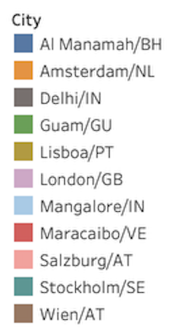
Per Country Recommendations: Saudi Arabia
RIPE Atlas
RIS & AuthDNS
Network Operator
We want to distribute probes to:
39891 ALJAWWALSTC-AS
43766 MTC-KSA-AS
35753 ITC
48695 ATHEEB-AS
21859 ZEN-ECN
13335 CLOUDFLARENET
Where?
End user network
Core network
IXPs
Networks that will improve hops to RIS infrastructure:
IXP route servers
39891
25019
39386
48695
Host AuthDNS in:
IXP
AS39891
AS25019
Evaluate the paths from your network to key infrastructure:
35819
47794
50999
208520

Slide 29
Per Country Recommendations: Palestine
RIPE Atlas
AuthDNS
Network Operator
We want to distribute probes to:
51407 Mada-AS
29310 JAWWAL
48966 WPT
12754 coolnet
51336 Gemzo
47253 AS-BNETSET
197350 zaytona
60636 coolnet-016-AS
211057 ps-astra
42013 Together-Communication-LTD
Where?
End user network
Core network
IXPs
Host AuthDNS in:
IXP
AS12975
AS51407
Evaluate the paths from your network to key infrastructure: AS12975
With only 2 probes in State of Palestine local support is needed to help getting probes connected in State of Palestine

Slide 30
Per Country Recommendations: Yemen
RIPE Atlas
RIS & AuthDNS
Network Operator
We want to distribute probes to:
30873 PTC-YemenNet
204317 Adennet
14593 SpaceX-Starlink
Where?
End user network
Core network
IXPs
Host AuthDNS in:
IXP
30873 PTC-YemenNet
204317 Adennet
Peer with RIS:
30873 PTC-YemenNet
There’s no RIPE Atlas connected in Yemen local support is needed to help getting probes connected

Slide 31
Per Country Recommendations: Syria
RIPE Atlas
RIS & AuthDNS
Network Operator
We want to distribute probes to:
29256 - INT-PDN-STE-AS
Where?
End user network
Core network
IXPs
Host AuthDNS in:
IXP
29256
Peer with RIS:
29256
29386
6866
There’s are NO RIPE Atlas probes or anchors connected in Syria local support is needed to help getting probes connected

Slide 32
Sources
RIPE Atlas Measurement Result: https://atlas.ripe.net/measurements/81446294/
RIS – How far is Internet from our infrastructure: https://observablehq.com/@emileaben/what-peers-would-decrease-as-distance-to-ris-most
https://labs.ripe.net/author/emileaben/does-the-internet-route-around-damage-baltic-sea-cable-cuts/
https://labs.ripe.net/author/anandb/reaching-authdns-a-ripe-atlas-analysis-by-region/

Slide 33
?
Questions & Comments
Lia Hestina <lhestina@ripe.net>
Ties de Kock <tdekock@ripe.net>

Slide 34
THANK YOU!

Slide 35
AS path from AuthDNS side
AS-path from Guam IX AuthDNS node to Atlas Anchor #7009
ns1.gu-gum.authdns.ripe.net# show ip bgp 45.94.14.204
BGP routing table entry for 45.94.14.0/24, version 63919178
Paths: (1 available, best #1, table default)
Not advertised to any peer
152735 7131 701 3257 8895 8895 208520, (aggregated by 208520 45.94.12.1)
103.142.153.1 from 103.142.153.1 (103.142.152.254)
Origin IGP, valid, external, atomic-aggregate, best (First path received)
Community: 65000:7131
Last update: Wed Nov 20 13:47:46 2024

Slide 36
Per Country Recommendations: Iran
RIPE Atlas
RIS & AuthDNS
Network Operator
We want to distribute probes to:
197207 MCCI-AS
16322 PARSONLINE
13335 CLOUDFLARENET
62240 Clouvider
42337 RESPINA-AS
41881 Fanava-AS
59573 SariSystemBandarabasCompany
48944 ASkhalijfarsonline
48147 AMINIDC
Where?
End user network
Core network
IXPs
Networks that will improve hops to RIS infrastructure:
IXP route servers
49666
42337
58224
43754
12880
48159
Host AuthDNS in:
IXP
AS197207
AS58224
Evaluate the paths from your network to key infrastructure
6736 | 25184 | 43965 | 48359 | 49556
9009 | 31549 | 44244 | 49551 | 51026
12880 | 39308 | 48147 | 48715 | 57218
14061 | 43754 | 48289 | 49100 | 58224
59441 | 197207 | 202468 | 205647 | 209836
62172 | 201227 | 205588 | 206065 | 212077

Slide 37
Per Country Recommendations: Türkiye
RIPE Atlas
AuthDNS
Network Operator
We want to distribute probes to:
15897 VodafoneTurkey
16135 TURKCELL-AS
20978 TT_Mobil
8386 KOCNET
12978 DSMART
34296 MILLENICOM-AS
Where?
End user network
Core network
IXPs
Host AuthDNS in:
IXP
AS9121
AS34984
Evaluate the paths from your network to key infrastructure: AS34904 (3 probes got answer from node in India)

Slide 38
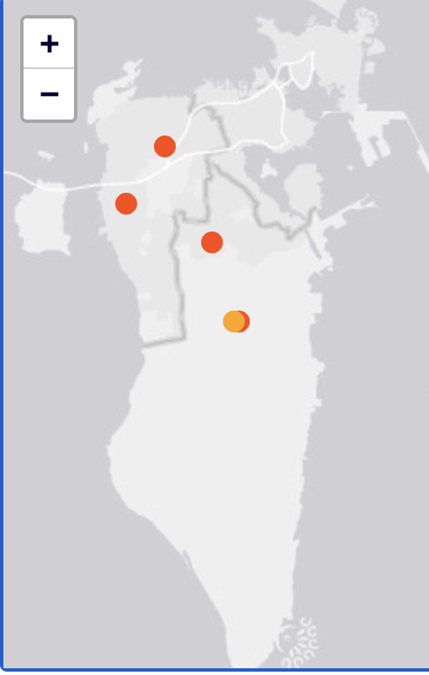
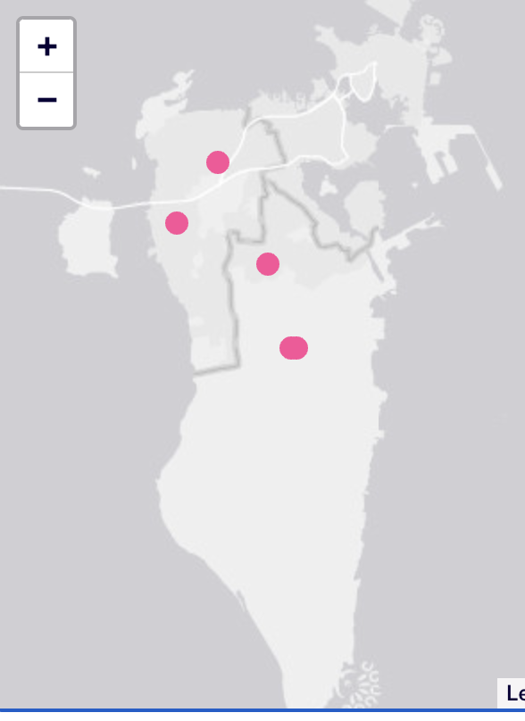
Bahrain: BGP takes a detour
RTT Amsterdam node
BGP selects an topologically long route:
One AuthDNS node in Bahrain, 6 probes
5 probes still prefer to go via Amsterdam
The RTT via Amsterdam is above 100ms
Notes:
This is an example of routing inefficiency? Need to improve peering.
How does this relate to RIS

